Slide 1
A Review of the Course Part 1
Geoff Hulten

Slide 2
Machine Learning Algorithms
Traditional Programming
Types of Machine Learning Algorithms:
Supervised (inductive) learning Training data includes desired outputs
Training data$<x, f\left(x\right)>$
Goal to learn $f(x)$ that matches training data
Unsupervised learning Training data does not include desired outputs
Semi-supervised learning Training data includes a few desired outputs
Reinforcement learning Rewards from sequence of actions
Program
Computer
Output
Data
Machine Learning
Output
Computer
Program
Data

Slide 3
Components of a Machine Learning Algorithm
Model Structure – Structure of the function the algorithm learns
Loss Function – What the learning algorithm optimizes for
Optimization – How the learning algorithm finds the best model

Slide 4
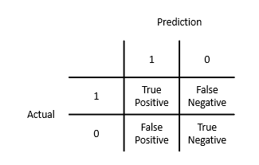
Basic Evaluation Metrics
Actual | Prediction
0 | 1
0 | 1
0 | 1
0 | 0
0 | 0
1 | 0
1 | 0
1 | 1
1 | 1
1 | 1
Accuracy: What fraction does it get right
(# TP + # TN) / # Total
Precision: When it says 1 how often is it right
# TP / (# TP + # FP)
Recall: What fraction of 1s does it get right
# TP / (# TP + # FN)
False Positive Rate: What fraction of 0s are called 1s
# FP / (# FP + # TN)
False Negative Rate: What fraction of 1s are called 0s
# FN / (# TP + # FN)
3
2
3
2

Slide 5
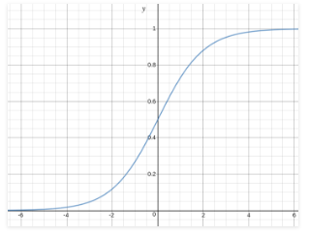
Structure of Logistic Regression
$y^{^}=sigmoid(w_{0}+ \sum_{i}^{n}{w_{i} ∗ x_{i})}$
$sigmoid\left(x\right)= \frac{1}{1+ e^{−x}}$
Threshold
Predict 0
Predict 1
Example:
W0 | W1 | W2
.25 | -1 | 1
X1 | X2
1 | 1
1 | 0
0 | 1
0 | 0

Slide 6
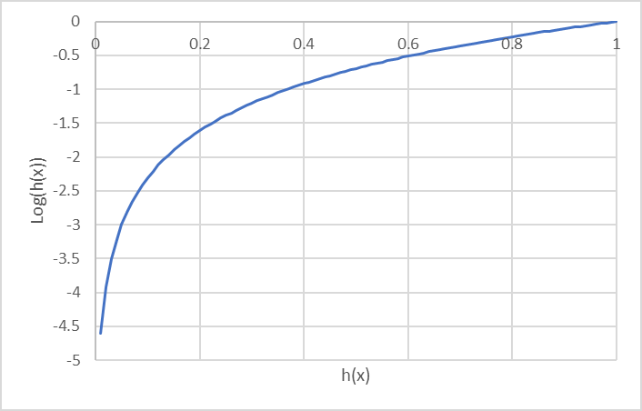
Logistic Regression – Loss and Optimization
Loss
Optimization
$$Loss\left(y^{^},y\right)=−log\left(y^{^}\right) If y=1$$
$$Loss\left(y^{^},y\right)=−log\left(1 − y^{^}\right) If y=0$$
$$\frac{∂Loss(TrainSet)}{∂w_{i}}=\frac{1}{n} \sum_{j}^{n}{\left(y_{j}^{^}−y_{j}\right)∗ x_{ji}}$$
Initialize weights to 0
Do ‘numIterations’ steps of gradient descent
Find the gradient for each weight by averaging across the training set
Update each weight by taking a step of size $∝$ opposite the gradient
Parameters
$∝$ – Step size
numIterations – # iterations of gradient descent
Threshold – to convert $y^{^}$into a classification
$$Loss\left(dataSet\right)=\frac{1}{n}\sum_{i}^{n}{Loss(y_{i}^{^},y_{i})}$$

Slide 7
Basic Feature Types
Binary Features
ContainsWord(call)?
IsLongSMSMessage?
Contains(*#)?
ContainsPunctuation?
Categorical Features
FirstWordPOS ->
{ Verb, Noun, Other }
MessageLength ->
{ Short, Medium, Long, VeryLong }
TokenType ->
{ Number, URL, Word, Phone#, Unknown }
GrammarAnalysis ->
{ Fragment, SimpleSentence, ComplexSentence }
Numeric Features
CountOfWord(call)
MessageLength
FirstNumberInMessage
WritingGradeLevel

Slide 8
Feature Engineering for Text
Tokenizing
Bag of Words
N-grams
TF-IDF
Embeddings
NLP

Slide 9
Intuition about the Normal Distribution
Central Limit Theorem: distribution of sample means approximates a normal distribution as the sample size gets large…
where the average of sample means is the population mean…
and the variance of the sample means is proportional to population variance…
$$Accuracy= \frac{\# Correct}{n}$$
$$σ_{Accuracy}≈ \sqrt{\frac{Accuracy(1 −Accuracy)}{n}}$$

Slide 10
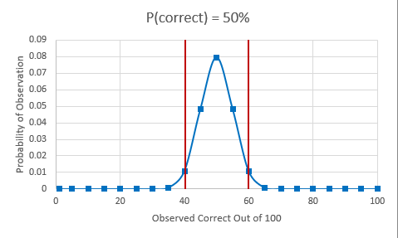
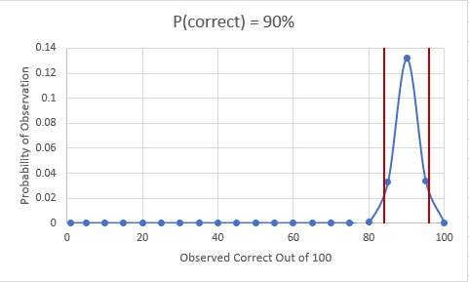
Confidence Intervals
Upper = $Accuracy+ Z_{N}∗σ_{Accuracy}$
Lower = $Accuracy − Z_{N}∗σ_{Accuracy}$
Confidence | 95% | 98% | 99%
$$Z_{N}$$ | 1.96 | 2.33 | 2.58

Slide 11
Comparing Models using Confidence Intervals
IF: Better_Model – Bound > Worse_Model + Bound
THEN: With XX% confidence the model that looks better on the sample is better
ELSE: there is more than a (1 - XX%) chance the model that looks worse is actually better
Bounds Overlap
Samples | Better_Model: 89% – Bound | Worse_Model: 80% + Bound
100 | 82.9% | 87.8%
200 | 84.7% | 85.5%
1000 | 87.0% | 82.5%
0%
10%
20%
30%
40%
50%
60%
70%
80%
90%
100%
0%
10%
20%
30%
40%
50%
60%
70%
80%
90%
100%
0%
10%
20%
30%
40%
50%
60%
70%
80%
90%
100%
95% Confidence Interval

Slide 12
Finding Hyperparameters with Cross Validation
Is some new parameter/feature worth the time/effort?
$$σ_{Accuracy}≈ \sqrt{\frac{Accuracy(1 −Accuracy)}{n}}$$
Train with and without feature
Compare using one sided bounds
Training Data
Validation Data
Bounds overlap?
Get more Data?
Stop Optimizing?
Test Data
Split data into k ‘folds’
Train with & without feature
on k-1; validate on 1
Use all validation data when calculating bounds
Probably want to reserve test data, depending on needs
Train
Train
Train
Validate
Validate
$${Accuracy}_{CV}=\frac{1}{n} \sum_{k}{{Correct}_{k}}$$
Train
Train
Validate
Train
Validate
Repeat n times
$$σ_{{Accuracy}_{CV}}≈ \sqrt{\frac{{Accuracy}_{CV}(1 −{Accuracy}_{CV})}{n}}$$
Validate
Train
Validate
Train
Train
Validate
Validate
Train
Train
Train

Slide 13
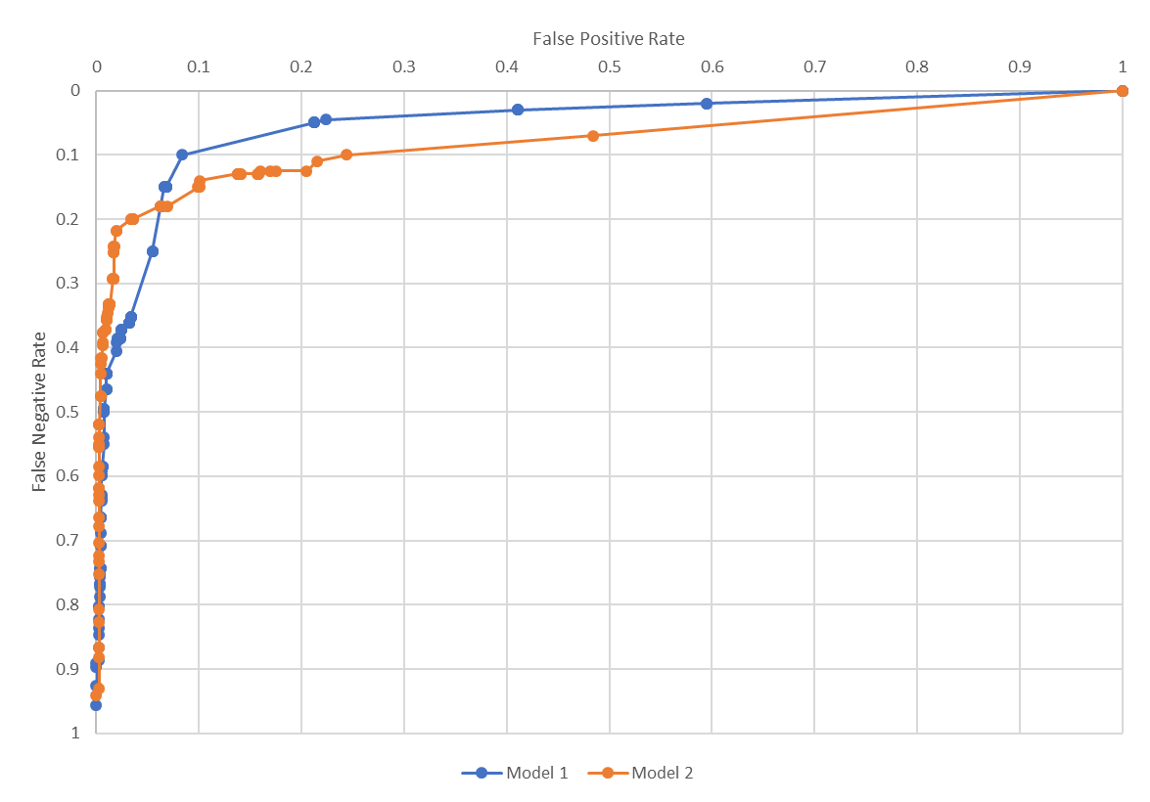
ROC Comparisons

Slide 14
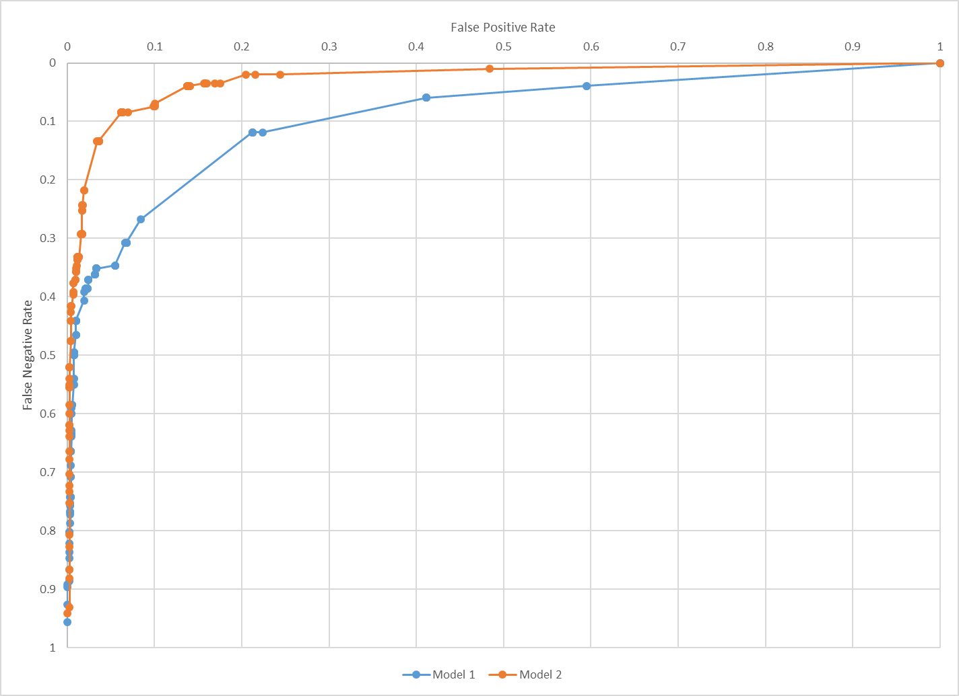
Operating Points
Balance Mistakes for your Application
Spam needs low FP Rate
Use separate hold out data to find threshold

Slide 15
Quick Note about MLE vs MAP
Maximum Likelihood Estimation (MLE)
Estimate probability from observations of data
Maximum A Posteriori (MAP)
Estimate probability from data and prior assumptions
$$P\left(Heads\right)= \frac{\#Heads}{\#Flips}$$
$$P\left(Heads\right)= \frac{\#Heads+m∗p}{\#Flips+m }$$
$$m −strength of prior \left(aka equivalent sample size\right)$$
$$p −prior estimate of P\left(Heads\right)$$
For assignments use m-estimates
with uniform p and small m
Example
$$m −10 and p −.5$$
$$P\left(Heads\right)= \frac{22}{50}=44\%$$
Flip a coin 50 times,
see 22 heads
$$P\left(Heads\right)= \frac{22+5}{50+10}=45\%$$
$$P\left(Heads\right)= \frac{1}{3}=33\%$$
Flip a coin 3 times,
see 1 head
$$P\left(Heads\right)= \frac{1+5}{3+10}=46\%$$
$$P\left(Heads\right)= \frac{0+5}{0+10}=50\%$$
$$P\left(Heads\right)= \frac{0}{0}=??\%$$
Flip a coin 0 times,
see 0 heads

Slide 16
Example of using Bayes Theorem
0.008
$$P\left(A | B\right)=\frac{P\left(B | A\right)P(A)}{P(B)}$$
0.992
0.98
0.02
$$P\left(cancer | +\right)=\frac{P\left(+ | cancer\right)P(cancer)}{P(+)}$$
0.03
$$P\left(+ | cancer\right)=0.98$$
0.97
??
$$P\left(y | <x>\right)=\frac{P\left(<x> | y\right)P(y)}{P(<x>)}$$
$$P\left(cancer\right)=0.008$$
$$P\left(− | cancer\right)=0.02$$
$$P\left(cancer | +\right)=\frac{0.98∗0.008}{P(+)}$$
$$P\left(+ | ¬cancer\right)=0.03$$
$$P\left(cancer | +\right)=\frac{0.98∗0.008}{0.0376}$$
Theorem of total probability
$$P\left(cancer | +\right)=.208$$
$$P\left(+\right)$$
$$P\left(+\right)=P\left(+ | cancer\right)P\left(cancer\right)+P\left(+ | ¬cancer\right)P(¬cancer)$$
$$P\left(+\right)=0.98 ∗0.008 +0.03 ∗ 0.992$$
$$P\left(+\right)=0.0376$$

Slide 17
Naïve Bayes
For each value of $y$:
Record # of times each possible <$x$>,$y$ occurs in training
Estimate $P\left(<x>\right| y)$ as:
$$\frac{\# times<x>, y occured}{\# of times y occured}$$
Won’t scale to many $x_{i}′s$…
$$y=\underset{y_{j}∈Y}{argmax}{\frac{P\left(<x>\right|y_{j}) P(y_{j})}{P(<x>)}}$$
$$y=\underset{y_{j}∈Y}{argmax}{P\left(<x>\right|y_{j}) P(y_{j}) }$$
$$y=\underset{y_{j}∈Y}{argmax}{P(y_{j})\prod_{i}{P(x_{i}|y_{j})} }$$
Assume each $x_{i}$ is independent of all the others
For each value of $y$:
For each value of $x_{i}:$
Record # of times $x_{i}=v$
Estimate $P\left(<x>\right| y)$ as: $\prod_{i}{P(x_{i}=v|y)}$
Independence
Assumption

Slide 18
Implementing with ML: ‘Run Time’ vs ‘Creation Time’
Param sweep
Model in Run Time
Intelligence Creation Environment
model.load(<dataFile>)
every time a page loads:
page = GetAppContext()
x = Featurize(model.words, page.words)
y = model.predict( [ x ] )
isFunny = y[0] > $t$
UpdateUserExperience( isFunny )
for every pageID in trainingSet:
( page, label ) = LoadPageFromLog( pageID )
pages.append( page ); Y.append( label )
(xTrainRaw, yTrain, xValidateRaw…) = SplitData(pages,Y)
selectedFeatures = FeatureSelect( xTrainRaw, yTrain <params> )
for xRaw in xTrainRaw:
x = Featurize( selectedFeatures, xRaw.words )
xTrain.append( x )
model = train( <more params>, xTrain , yTrain )
$t$ = FindThreshold( thresholdSet )
model.save(selectedFeatures, $t$, model)
# Deploy it…
Must be in sync!
Must be in sync!
Validation Set Stuff
More param sweeps
Intelligence Management

Slide 19
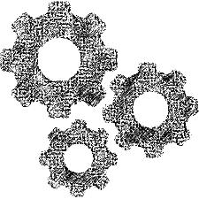
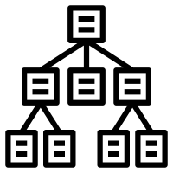
Summary: Components of an Implementation
Intelligence Management
Verify new intelligence
Control rollouts:
Keep in sync
Clients/services
Support online evaluation
Intelligence Creation Environment
Intelligence Runtime
Intelligence Orchestration
Monitoring success
Inspect Interactions
Adapt as things change
Deal with mistakes
Updating thresholds
Drive the racecar
Program State -> Context
Execute Feature Code
Execute Model
Interpret Model Output
Control User Experience
Update:
Models
Feature Code
Telemetry -> Context
Feature code in sync
Computation & Data
All the training stuff…
Telemetry
Verifying outcomes
Training data
Selecting what to observe
Sampling
Summarizing

Slide 20
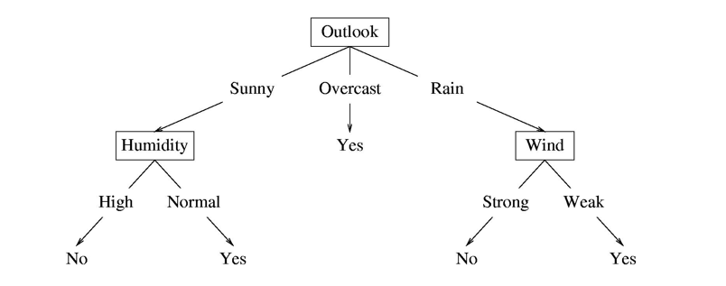
Structure of a Decision Tree
Internal nodes test feature values
One child per possible outcome
Leaves contain predictions
Humidity | Outlook | Wind | Prediction
Normal | Rain | Strong
High | Sunny | Normal

Slide 21
Decision Trees: Basics
Internal Nodes
Leaves
Binary Feature
Categorical Feature
Numeric Feature
$$x_{i}=0?$$
Classification
Regression
Probability Estimate
$$y=1$$
False
True
$$x_{i}?$$
$$y=101.2$$
$${Value}_{1}$$
$${Value}_{n}$$
…
$$p\left(y=0\right)= .3$$
$$p\left(y=1\right)= .3$$
$$p\left(y=2\right)= .4$$
$$x_{i}<101.2?$$
False
True

Slide 22
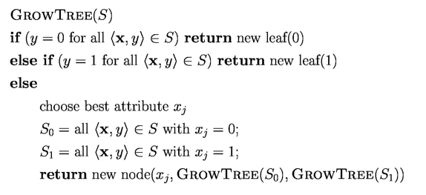
Decision Tree Optimization
SplitEntropy(S, $x_{i}$)
entropySum = 0
for $S_{val}$ in SplitByFeatureValues(S, $x_{i}$)
entropySum += Entropy($S_{val}$ ) * len($S_{val}$)
return entropySum / len(S)
Partition data set by selected feature
Termination condition
InformationGain(S, $x_{i}$)
return Entropy(S) – SplitEntropy(S, $x_{i}$)
One step lookahead
BestSplitAtribute(S)
informationGains = {}
for i in range(# features):
informationGains[i] = InformationGain(S, i)
if AllEqualZero(informationGains):
# Additional Termination Case…
return FindIndexWithHighestValue(informationGains)
Recursive calls on partitioned data sets
$$Entropy\left(S\right)=−\sum_{i∈\{y\}}{p\left(y=i\right)∗\log_{2}(p\left(y=i\right))}$$

Slide 23
Types of goals
Model Properties
User Outcomes
User Churn
User studies show 80% think we’re good at spam
Profit
Models + UX Create
Monthly Active Users
Subscription Revenue Growth
‘bad’ FPR < 0.1%
New spam attack stopped in < 1 hour
Users spend less of 2% of time in app on spam
Good Outcomes Improve
FNR < 5% & 1% FPR
User sees less spam than on competitor
Leading Indicators
Organizational Objectives
Precision = 99%
Avg User reports < 1 spam a month
Cost of managing spam < 1% of service cost
Happy, Engaged Users Lead to
Monthly Sent per User
Total cost (FP 10; FN 1)
Users recommend the service to their friends
User sees fewer than 5 spam a week
Avg User Inbox < 5% spam

Slide 24
Balancing an Intelligent Experience
Forcefulness
Frequency
Value of Success
Cost of Failure
Quality of the Intelligence
If the intelligence is poor…
E.g. when the system is new
If the cost of a mistake is high…
E.g. a surgical robot
If there is legacy UX…
E.g. integrating into an existing application

Slide 25
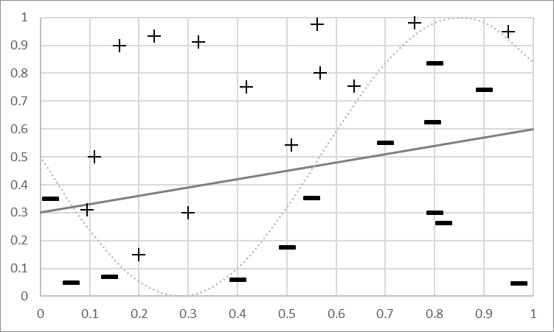
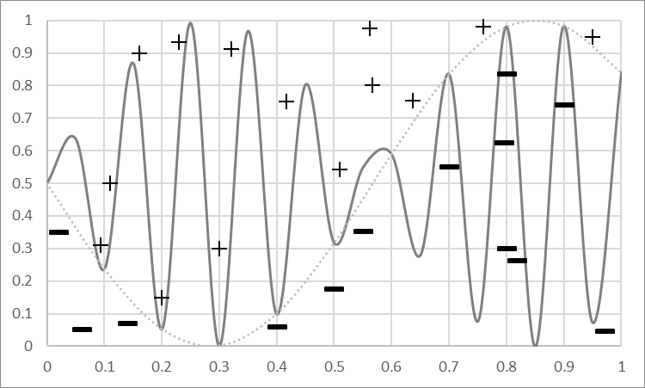
Bias and Variance
Bias Mistakes
Model Predicts +
Bias –
error caused because the model can not represent the concept
Variance –
error caused because the learning algorithm overreacts to small changes (noise) in the training data
TotalLoss = Bias + Variance (+ noise)
Model Predicts -
Model
Predicts +
Model Predicts -

Slide 26
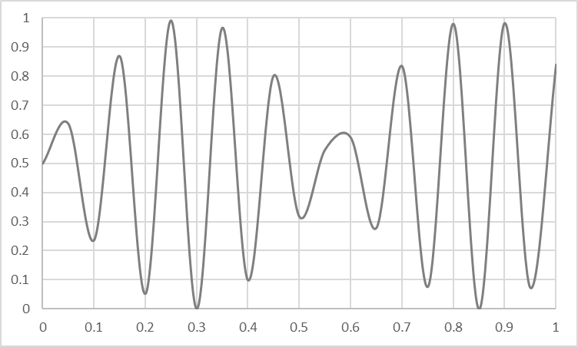
Overfitting vs Underfitting
Overfitting
Underfitting
Fitting the data too well
Features are noisy / uncorrelated to concept
Modeling process very sensitive (powerful)
Too much search
Learning too little of the true concept
Features don’t capture concept
Too much bias in model
Too little search to fit model

Slide 27
Bagging
Parallel Training
Possible
Base Models
Uniform voting
to classify new samples
Bootstrap Sample
Training Set
Sample 1
Ensemble Prediction
Training Set
Sample 2
Training
Set
…
…
Generate K training sets by sampling from the original training set
“Bootstrap” sample
Training set contains N training examples
Each of the K training sets also contains N training examples
Created by sampling with replacement from the original
Learn one model on each of the K training sets
Combine their predictions by uniform voting
Training Set
Sample K
Sample
Train
Vote

Slide 28
Random Forests
Build N trees
Bootstrap sample for each training set (Bagging)
Restrict the features each tree can use
Combine by uniform voting

Slide 29
Example RandomForest Predict
$$x_{1}=1?$$
False
True
$$x_{2}=1?$$
False
True
$$x_{1}$$ | $$x_{2}$$ | $$x_{3}$$ | $$y$$
0 | 0 | 0
0 | 0 | 1
0 | 1 | 0
0 | 1 | 1
1 | 0 | 0
1 | 0 | 1
1 | 1 | 0
1 | 1 | 1
$$y=1$$
$$x_{2}=1?$$
False
True
$$y=0$$
$$y=1$$
$$y=1$$
$$y=0$$
$$x_{3}=1?$$
False
True
$$x_{3}=1?$$
False
True
$$x_{1}=1?$$
$$y=0$$
False
True
$$y=1$$
$$y=0$$
$$y=1$$
$$y=0$$

Slide 30
Good Luck!

